Slide 1

EquiCrowd
Guided Crowdfunding Service using ML
Team Name: Data Wizards

Slide 2


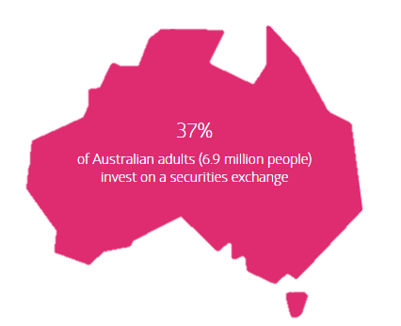
YOUR TITLE GOES HERE 2
PROBLEMS
Investors
Lack of knowledge and understanding
Taxing research process
No monetary value
Lack of trust
New Start-ups in Australia
354,520
Global Crowdfunding Market Value
2019: USD 6,923.6m
Projected 2030: USD 300 billion
Start-ups
Limited Audience Outreach
Time Consuming
Limited Expertise
Expensive
This Photo by Unknown Author is licensed under CC BY

Slide 3




YOUR TITLE GOES HERE 2
EquiCrowd POSITION
Guided
EquiCrowd
Rewards
Equity Crowdfunding
Unguided
This Photo by Unknown Author is licensed under CC BY

Slide 4
YOUR TITLE GOES HERE 2
SOLUTION
Profile
Validation: Open Banking
Check: Person of Interest
Dashboards
Text Summary using NLP
Social Media Sentiment Analysis
Transaction
Blockchain - Investment History
Project Milestone Tracker
Insight Analysis
This Photo by Unknown Author is licensed under CC BY

Slide 5



YOUR TITLE GOES HERE 2
BURROWER
Connects with diversified audience
Insights on Investment pattern
Increase Transparency
Monetary Value:
Capital Funds Raised within Timelines
BANK
Huge Data Repository
Upselling services
Monetary Value:
Gaining interest on Hold Money
Commission per transaction
INVESTOR
Faster Investment literacy
Data driven insights
Diverse Investment portfolios
Monetary Value:
Tax-saving-early innovation investment
Business Value
This Photo by Unknown Author is licensed under CC BY
Notes:
Investor Returns:
Company acquisition
IPO
Dividends
Trading Shares

Slide 6
THANK YOU

Slide 7
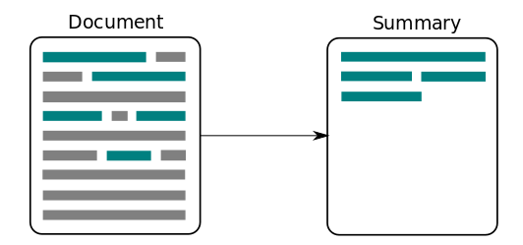

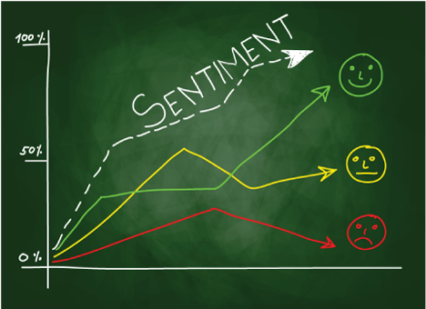
YOUR TITLE GOES HERE 2
Machine Learning and Analytics Stack
Unsupervised Text Summarization
Tableau Visualization from
Investor and
Burrower’s perspective
Social Media Sentiment
Analysis over time
This Photo by Unknown Author is licensed under CC BY

Slide 8
YOUR TITLE GOES HERE 2
New Start-ups in Australia
354,520
MOTIVATION
Global Crowdfunding Market Value
2019: USD 6,923.6m
2030: USD 300 billion
This Photo by Unknown Author is licensed under CC BY

Slide 9
YOUR TITLE GOES HERE 2
SOLUTIONS
Investors
Knowledge Gap met Using
Machine Learning, Artificial Intelligence,
Sentimental Analysis and Recommendation
Start-ups
Large Target Audience for Investments
This Photo by Unknown Author is licensed under CC BY

